Slide 1
ANDROID
DEVELOPMENT
Palak singhal
02196303116
IT (e)
iNDUSTRIAL training presentation

Slide 2


ABOUT WAC (WHAT AFTER COLLEGE)

Slide 3
fields of wac
MBA
Civil Services
Entrepreneurship
IT jobs
Study Abroad

Slide 4

ABOUT KYRION
Team at Kyrion believes that opportunities are borne out of imperfections. Their Education Entrepreneurship Firm, aims to deliver the high-end security solutions and training to the students and corporates to prepare them to meet the challenges of the IT security industry.
Since 1983, chcharity has driven evolution in charity websites: they pioneered real time news distribution to financial terminals in 1990’s, they were first to provide their customers with the ability to post news to their social media channel at the same time as their traditional channels, and they continue to lead the industry with news release reporting and analytics that is critical to our customers’ success.
They take pride in being responsive, making a difference at a critical point in peoples’ lives. They have been doing this since 1944, working with veterans of every conflict, and we envisage continuing doing so for the ‘long-haul’ – supporting all future generations of our soldiers and their dependents

Slide 5
KYRION
WAC

Slide 6
Week Wise Schedule
 | No. of days scheduled for training | Curriculum Scheduled for students
WEEK 1 | 3 | Basic Java
WEEK 2 | 3 | Android Studio setup & XML designing
WEEK 3 | 3 | Advance XML designing & material designing
WEEK 4 | 3 | Intent, Activity & Fragments
WEEK 5 | 3 | Event Handling & Advanced layouts i.e. Gridview, Gallaryview
WEEK 6 | 3 | Database SQLite, shared Preferences

Slide 7
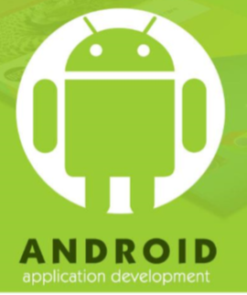
What is android ?
Android is an open source and Linux-based Operating System for mobile devices such as smartphones and tablet computers. Android was developed by the Open Handset Alliance, led by Google, and other companies.
Android offers a unified approach to application development for mobile devices which means developers need to develop only for Android, and their applications should be able to run on different devices powered by Android.
The first beta version of the Android Software Development Kit (SDK) was released by Google in 2007, whereas the first commercial version, Android 1.0, was released in September 2008.
On June 27, 2012, at the Google I/O conference, Google announced the next Android version, 4.1 Jelly Bean. Jelly Bean is an incremental update, with the primary aim of improving the user interface, both in terms of functionality and performance.
The source code for Android is available under free and open source software licenses. Google publishes most of the code under the Apache License version 2.0 and the rest, Linux kernel changes, under the GNU General Public License version 2.

Slide 8


project
Balloon Popper App

Slide 9
introduction
The era of mobile technology opens the windows to the android apps. The websites are vanishing and the mobile phones are emerging. It’s the time to change from conventional websites to mobile apps, which has already became the part of our daily routine. From waking up early in morning to late night sleep time, we are more or less dependent on apps to make our life easy. Android games are becoming very popular. They are mind refreshing and stress relieving. They provide us a good source of passing time. Many of these games are so addicting that one can play them for hours without break. Balloon Popper is also a basic game App. It improve our reflexes to act immediately and also makes us stress free. In this game we have to pop all balloons appearing on our screen by touching on them as our finger acts as a pin for those balloons. Background of the app is an image which has many building shades. We have five chances, if we miss a balloon one pin or chance gets reduced. It has ten levels with ten balloons to pop in each level. With the increase in level, the speed of emerging balloons also increase. After every level completed, we are allowed to take pause and start the game again when we are ready. We are notified if we scored the highest. It also has a background music to make us feel more relaxed.

Slide 10
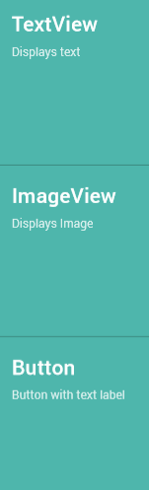
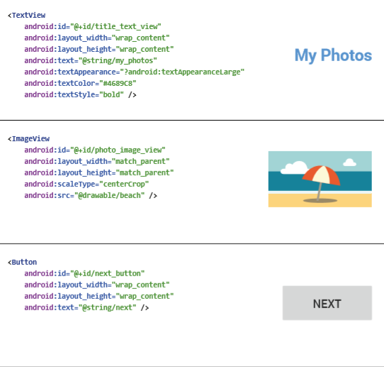
XML Designing

Slide 11
Implementing java
Following are the classes (Java class files) we need to define for the complete and proper functioning of app:
Ballon.java: Created for animating colorful balloons
PixelHelper.java: For converting height and width from pixels to dp.
PreferencesHelper: To store the score and levels and also to update the high score and max reached levels.
SoundHelper: To manage the background music and popper sound of the App.
MyAlertDialog: To display the high score and high levels view.
Main: It is like a control center to manage the functioning of all other classes.

Slide 12
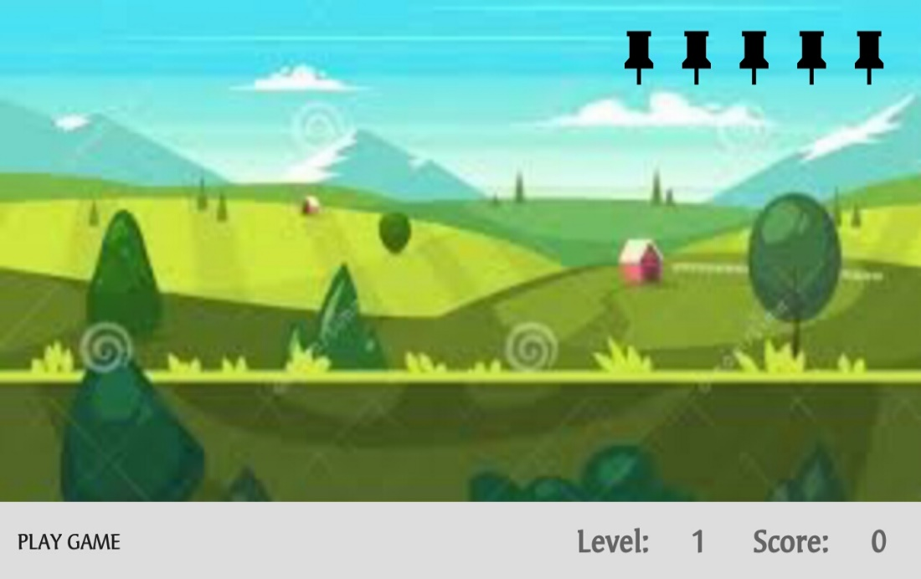
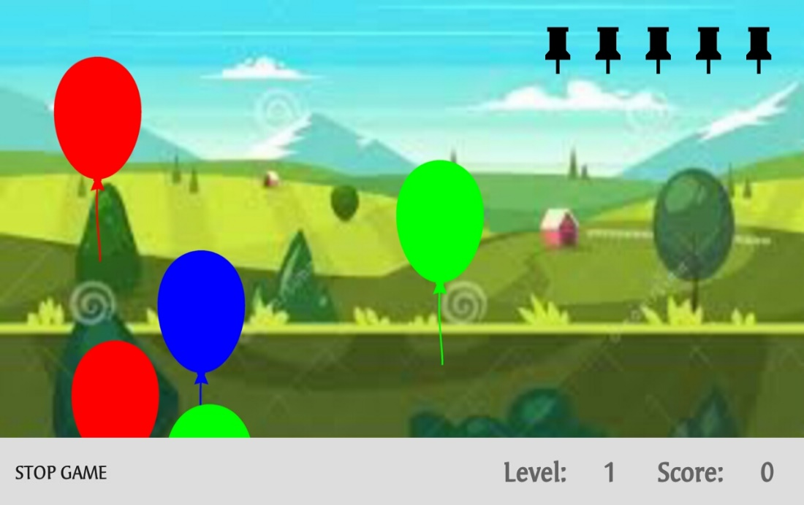
Fig. 1 Launching Screen
Fig 2 After starting game

Slide 13
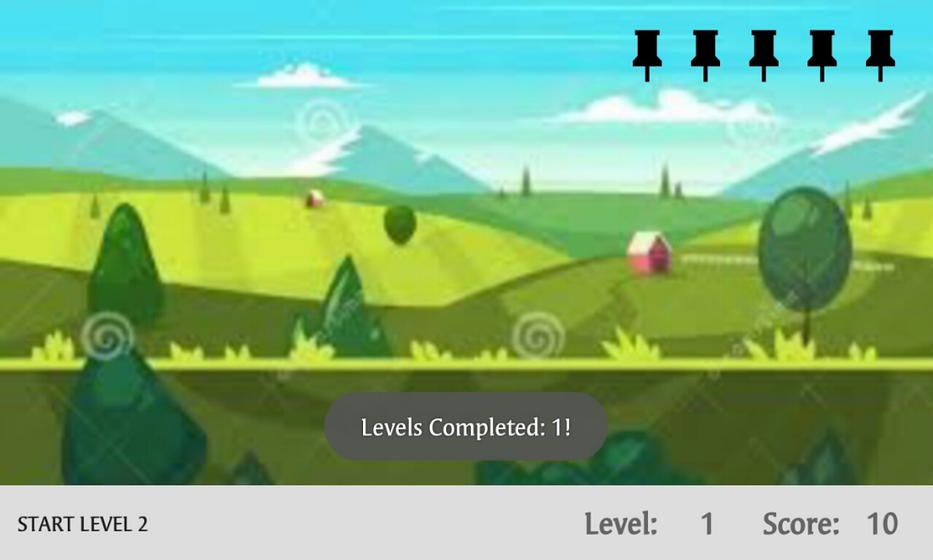
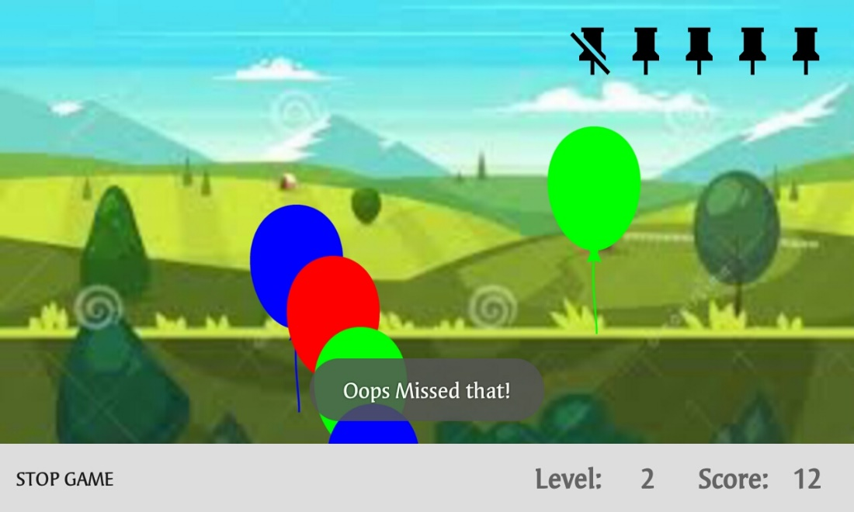
Fig 3 On completing a level
Fig 4 On missing a balloon

Slide 14
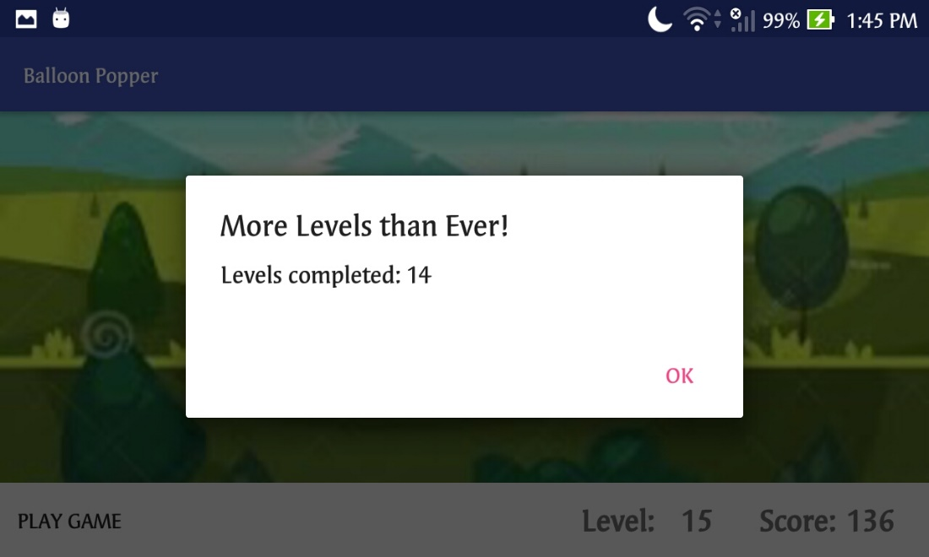
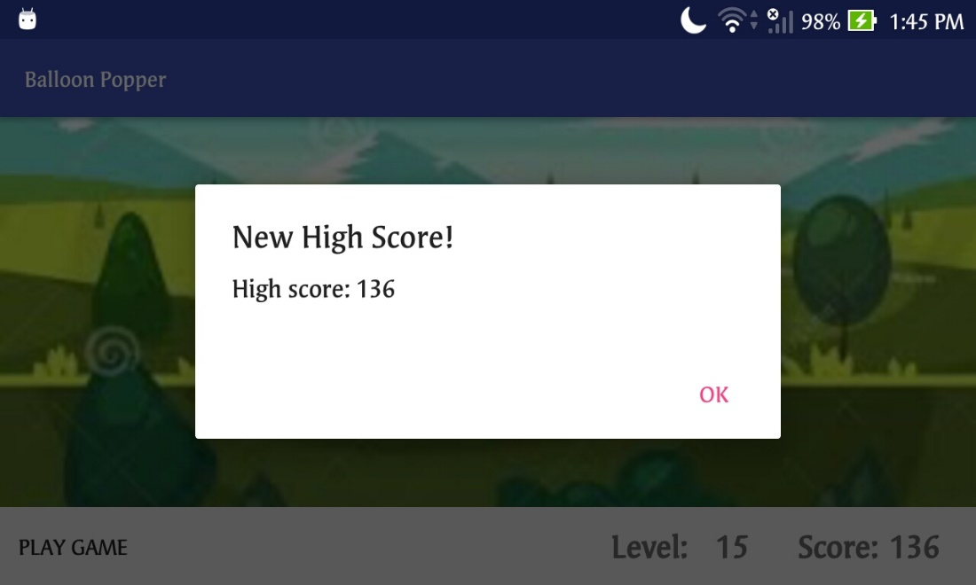
Fig. 5 High levels Notification
Fig. 6 High Score Notification

Slide 15
conclusion
The training proved pretty beneficial for me as I developed new skills for developing android apps. During this training I learned a lot:
Java Basics
Android Studio Basics
XML Layouts
Material Designing and Advanced Layouts
Java Event Handling
Shared Preferences
Fragments
I learned all the above things. Before this training, I had no idea about core java and Android for mobile apps. Although I had a little bit knowledge about java and its syntax. Learning android was a new and good experience. Now I know more than before and can develop mobile applications. Balloon Popper App that I made has used all of these concepts and some more

Slide 16
Thank you

